Slide 1

Resume
Ching-Lung Li
Jun. , 2011
Reporter
2010
Ching Lung Li

Slide 2
2009
Reporter
2009
Ching Lung Li
Notes:
I’d like to structure my presentation according to this sequence, it is divided into four parts. First, I’ll spend a few minutes introducing the overall configuration of our multi-touch system. Second, I’m going to talk about the structure and the main features of the resistive multi-touch panel. Next, I’ll discuss the part of software development in our multi-touch system. And finally, I’ll show you a video clip about the performance of using multi-touch function on our embedded system.

Slide 3
Agenda
Linux Input Subsystem
Linux USB core
CPT touch panel USB - CPT Touch Linux Driver Architecture - CPT Touch Linux Driver process
Demo
Brief Introduction of STN LCD Driver
Future Work
200909

Slide 4
CPT Touch Panel Linux Driver Architecture
200909
Notes:
4

Slide 5
Agenda
Driver : Linux multi-touch driver
Library : tslib
- linear 演算法 : 線性化
- dejitter 演算法 : 去除抖動
- calibrate 演算法 : 五點座標校正
AP : Multi-Touch Application
- using Linux C
200910

Slide 6
Linux Multi-touch Drivers
Linux Driver support and porting
Cypress
- single-touch(support wheel)
- multi-touch (two point sample)
數位電阻式
- multi-touch(three point sample)
偉詮
- standard HID format(single point sample)
Notes:
6

Slide 7
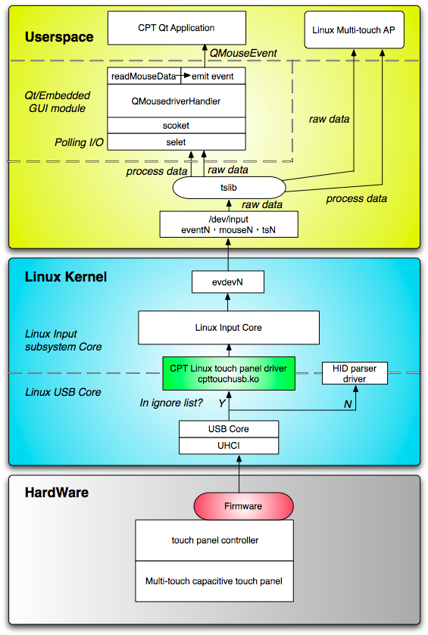
Framework
Linux Multi-touch
Framework
1 evdev
Pass through tslib
Notes:
7

Slide 8
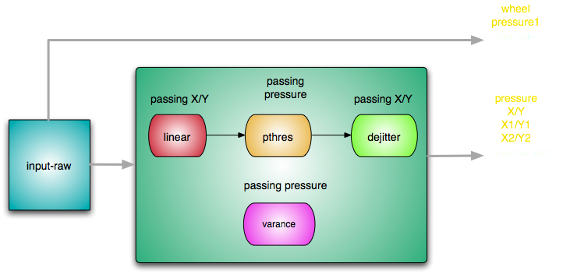
Touch-screen Library
Passing and Porting
Source code modification input-raw.c , linear.c , pthres.c , dejitter.c , varance.c
Notes:
8

Slide 9
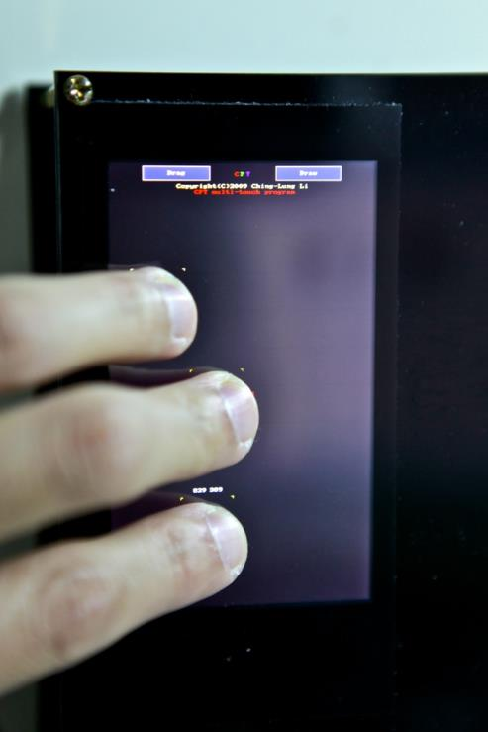
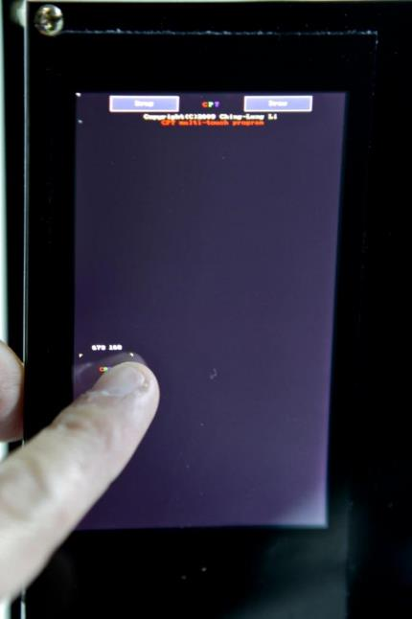
Linux Multi-touch AP
遊標顯示(最多3點)
Notes:
9

Slide 10
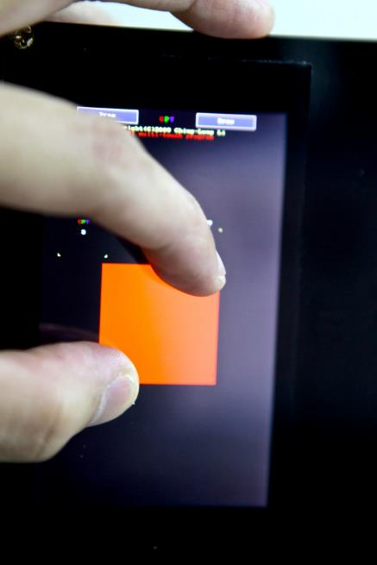
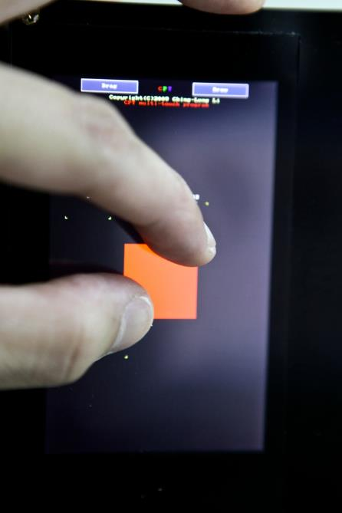
Linux Multi-touch AP
(兩點手勢)放大
(兩點手勢)縮小
Notes:
10

Slide 11
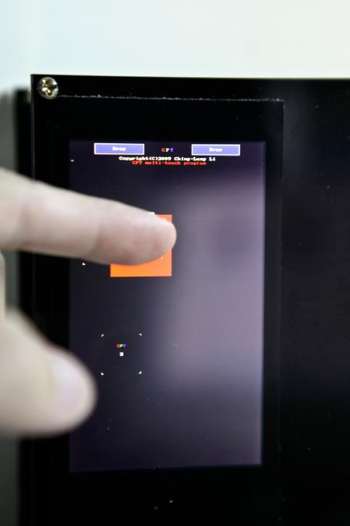
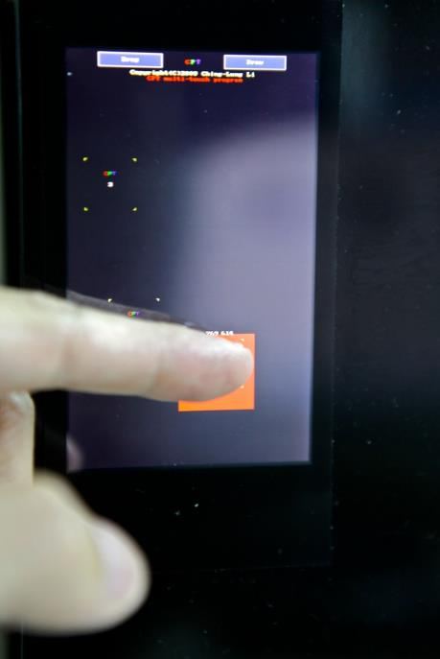
Linux Multi-touch AP
單點拖移
Notes:
11

Slide 12
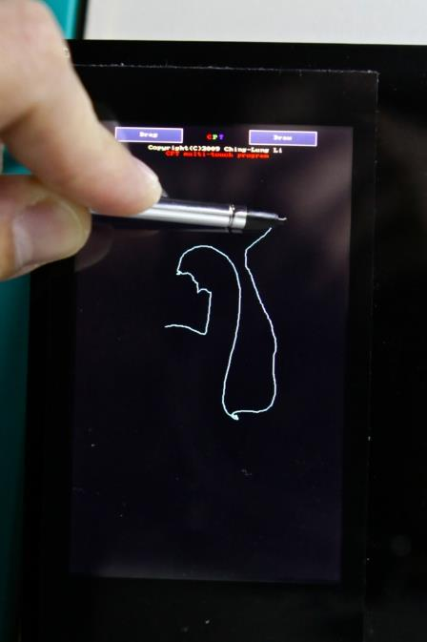
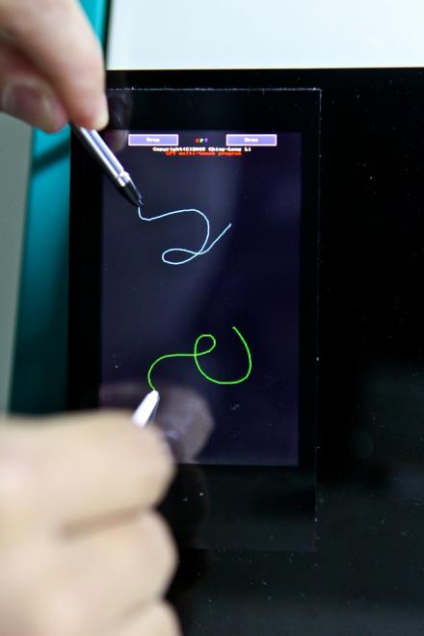
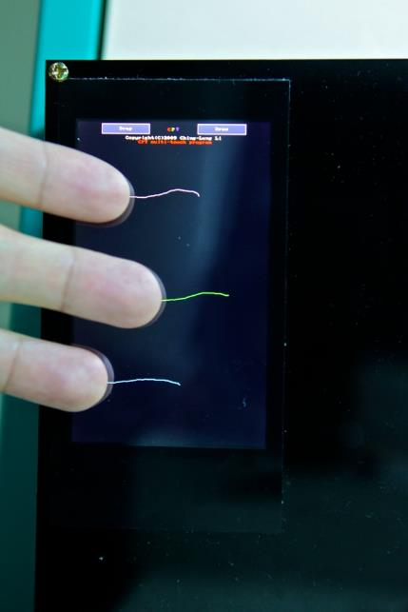
Linux Multi-touch AP
小畫家(支援三點同時畫圖，線性化優)
Notes:
12

Slide 13
Future Work
Linux I2C Driver study
Intensify Multi-touch AP
Linux USB driver support more touch panel hardware
Develop ARM11 system with OS Linux 2.6.24
Qt 4.6 Beta (support it’s multi-touch format)
Notes:
13

Slide 14


2010
Reporter
2010
Ching Lung Li
Notes:
I’d like to structure my presentation according to this sequence, it is divided into four parts. First, I’ll spend a few minutes introducing the overall configuration of our multi-touch system. Second, I’m going to talk about the structure and the main features of the resistive multi-touch panel. Next, I’ll discuss the part of software development in our multi-touch system. And finally, I’ll show you a video clip about the performance of using multi-touch function on our embedded system.

Slide 15
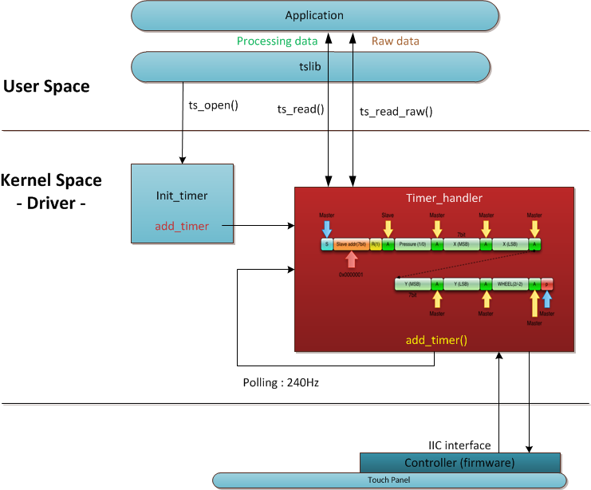
相關錯誤說明 2
It maybe sleep !!
mutex_lock_nested()
mutex_unlock()
0x06
I2c_transfer()
201001

Slide 16
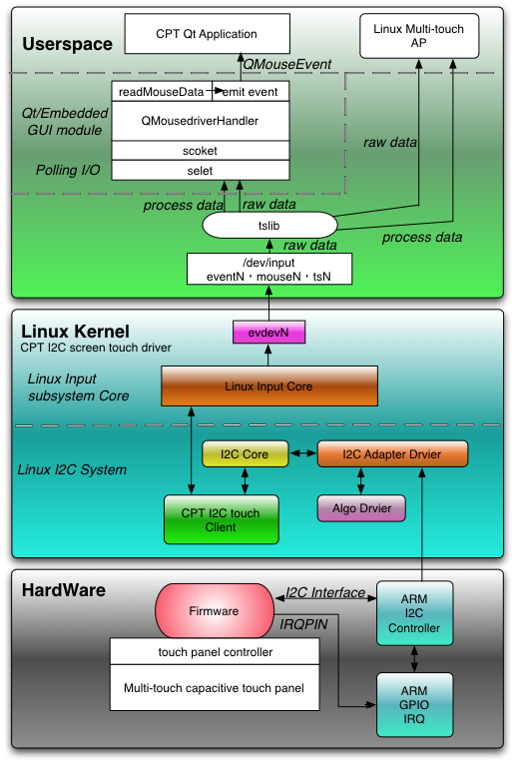
CPT Linux I2C Touch Screen Software
System

Slide 17
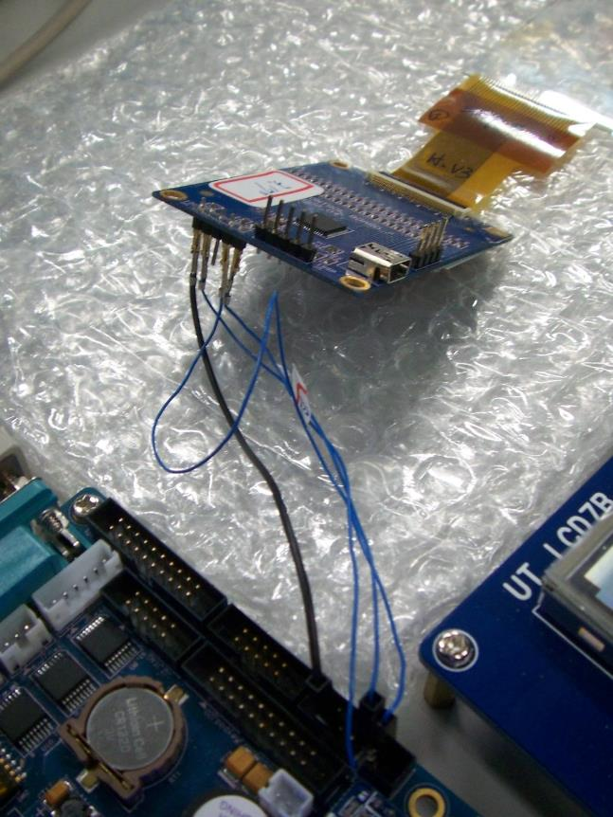
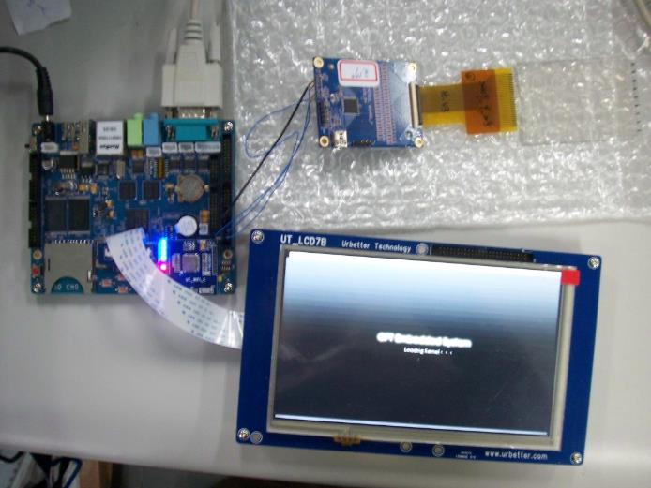
成果 - 系統
ground
SCL
Power
SDA
Power
ground
SDA
SCL

Slide 18
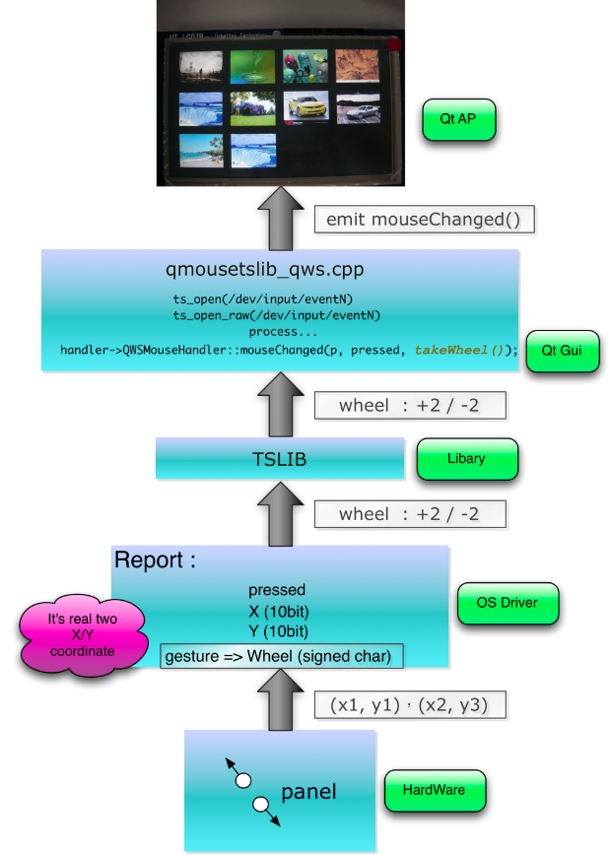
璟正 – 驅動程式端 gesture(mouse)
201003

Slide 19
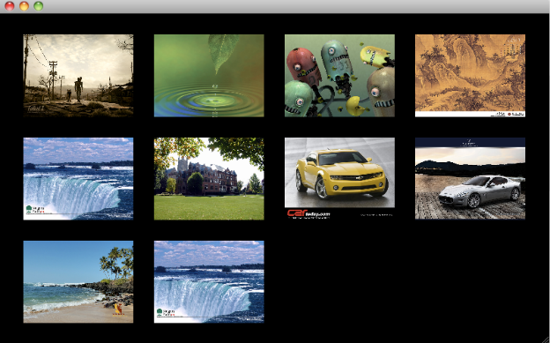
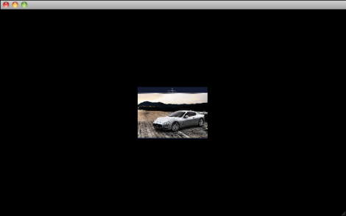
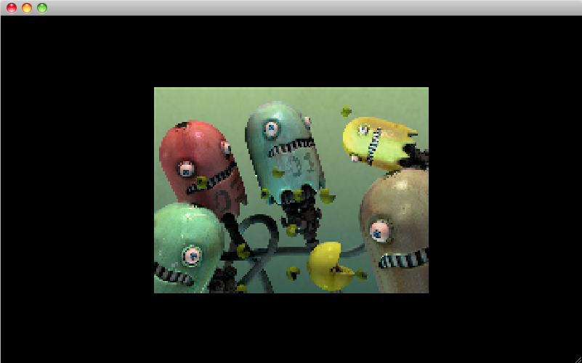
New Qt Application demo
201003
Index mode
Album mode
Show mode

Slide 20
2010/04
Reporter
2010
Ching Lung Li
Notes:
I’d like to structure my presentation according to this sequence, it is divided into four parts. First, I’ll spend a few minutes introducing the overall configuration of our multi-touch system. Second, I’m going to talk about the structure and the main features of the resistive multi-touch panel. Next, I’ll discuss the part of software development in our multi-touch system. And finally, I’ll show you a video clip about the performance of using multi-touch function on our embedded system.

Slide 21
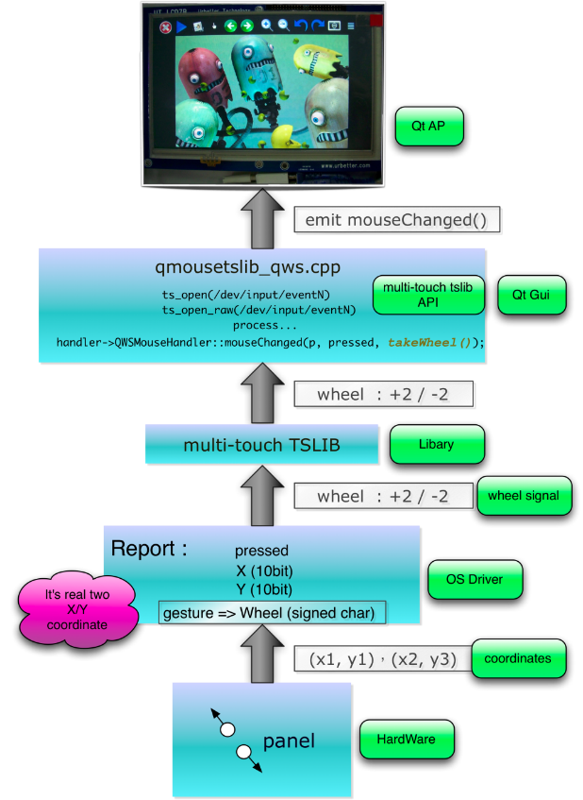
focaltech touch panel - gesture

Slide 22
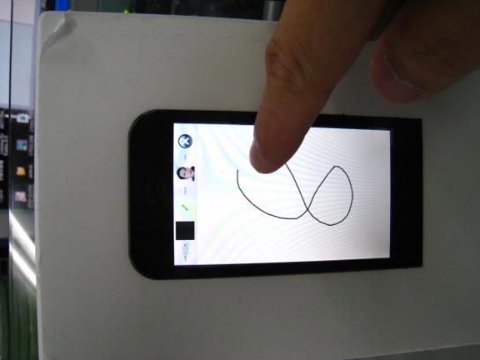
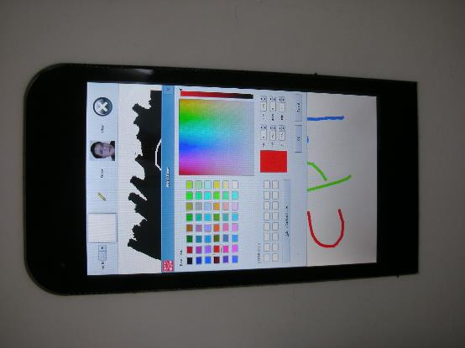
Focaltech touch panel demo 3
Painter
Good linearity
Good performance
Colorable

Slide 23
2010/05
Reporter
2010
Ching Lung Li
Notes:
I’d like to structure my presentation according to this sequence, it is divided into four parts. First, I’ll spend a few minutes introducing the overall configuration of our multi-touch system. Second, I’m going to talk about the structure and the main features of the resistive multi-touch panel. Next, I’ll discuss the part of software development in our multi-touch system. And finally, I’ll show you a video clip about the performance of using multi-touch function on our embedded system.

Slide 24
Agenda
Progress of Qt Applications - CPT slide photo browser - CPT painter - CPT animation photo browser
New touch applications
SKDL 2010

Slide 25
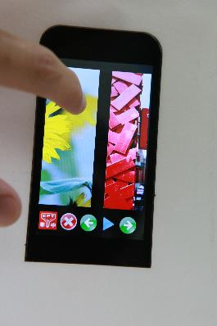
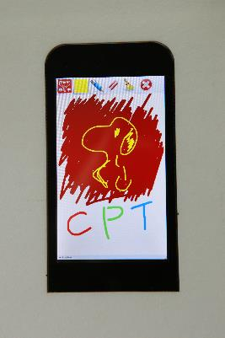
CPT slide photo browser ： - 可手指滑移照片控制瀏覽照片上下張功能 - 可判斷手指速度控制照片滑移速度效果 - 支援 gesture：zoom in and zoom out - 支援 slideshow - 支援rotation（mask） CPT painter ： - 支援 gesture： 筆刷與橡皮擦粗細控制 - 界面更新
Feature

Slide 26
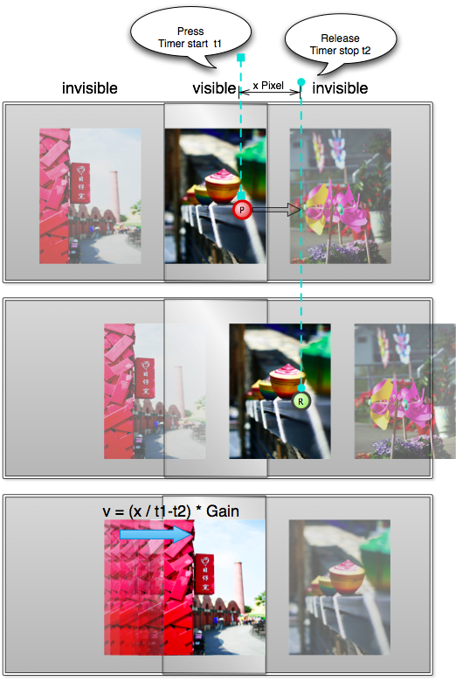
CPT slide photo browser ： 1. 一次載入多圖，在切換顯示下一張或上一張照片時無讀取時間，更有效率。 2. 以press與release的相對時間與手指滑移的像素長計算手指速度進而控制圖片滑移速度。
New touch Applications

Slide 27
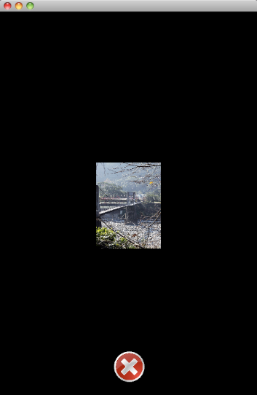
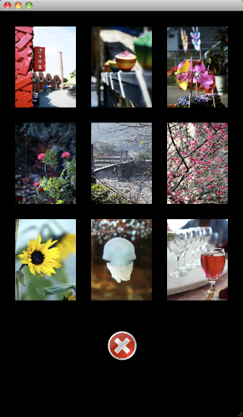

CPT animation photo browser ： 1. 開發中，由於程式結構關係，目前無法關閉程式，只能單一執行，需對Qt中Graphics View相關物件做更深入之了解。
New touch Applications

